Slide 1
Photomicrographs of Plant foods
Pea, Snow
Permission to reproduce original photomicrographs used to make this collection may be obtained from
Dr. David O. Norris at
david.norris@colorado.edu

Slide 2
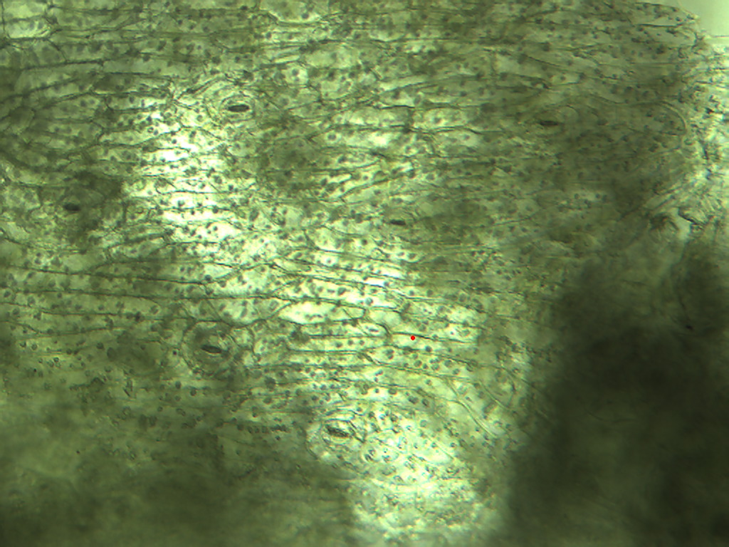
Notes:
335. Pisum sativum L. Pea, snow. Elongate epidermal cells and stomates (arrows) in pod, 10X.

Slide 3
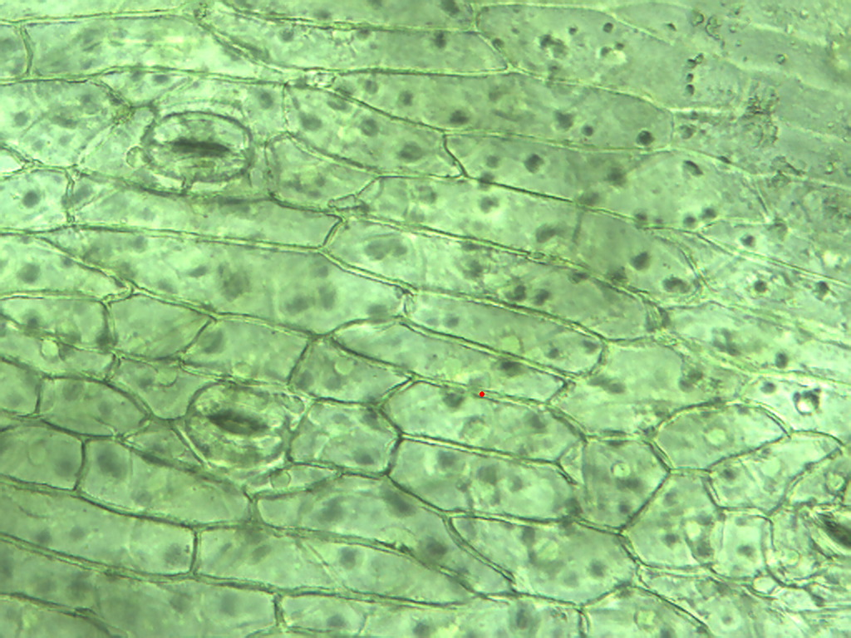
Notes:
336. Pea, snow. Epidermal cells of pod with stomate (arrows), 25X.

Slide 4
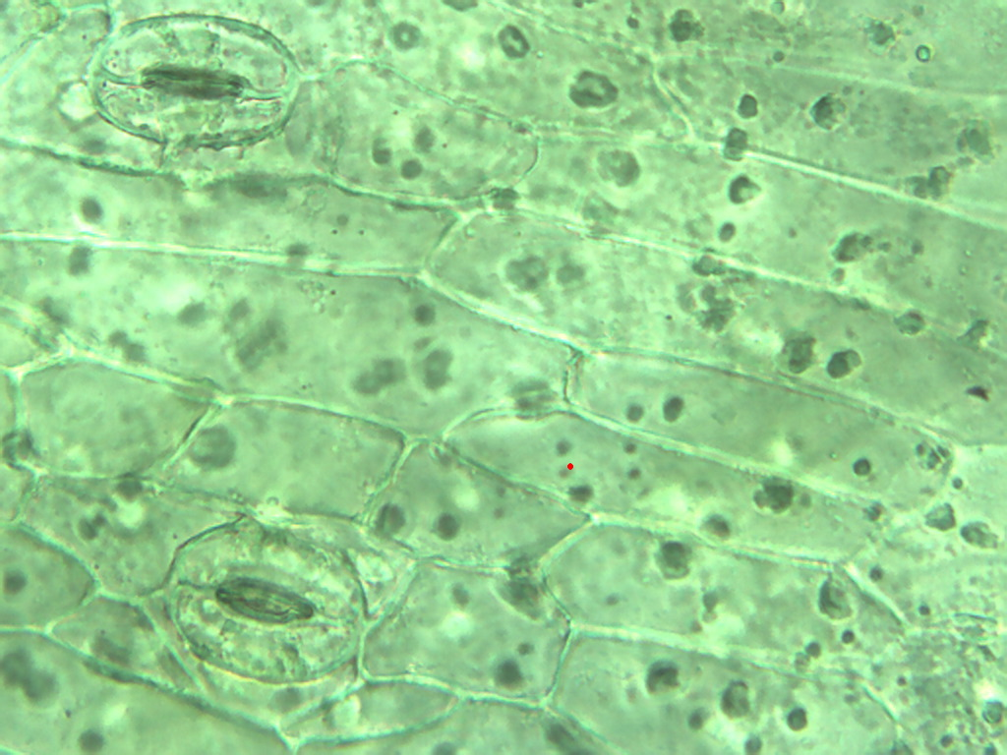
Notes:
337. Pea, snow. Pod epidermis with stomates (arrows), 40X.

Slide 5
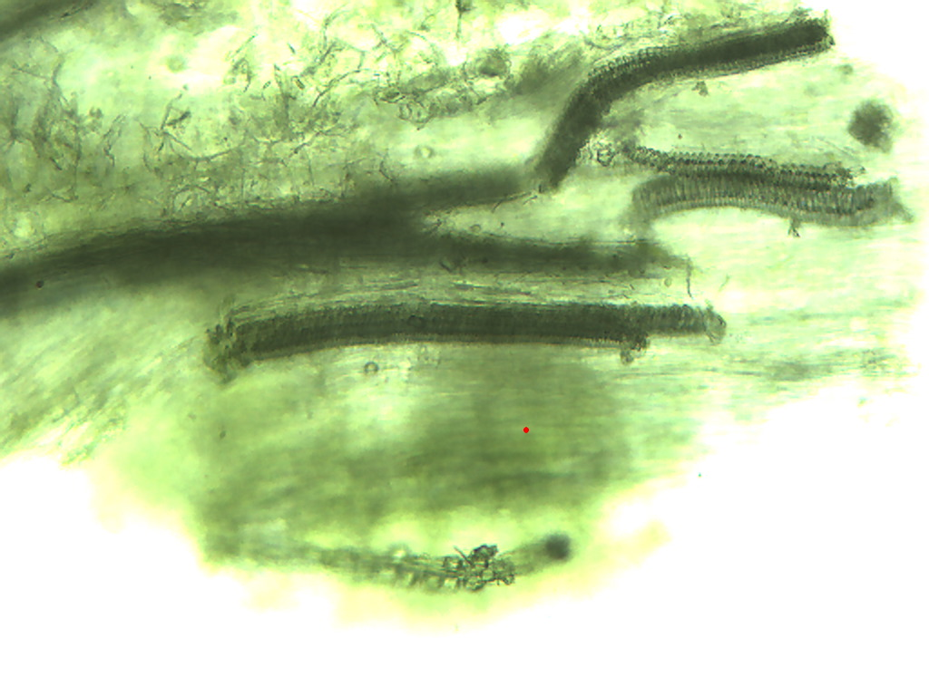
Notes:
338. Pea, snow. Vascular tissue (vessels) in pod, 10X.

Slide 6
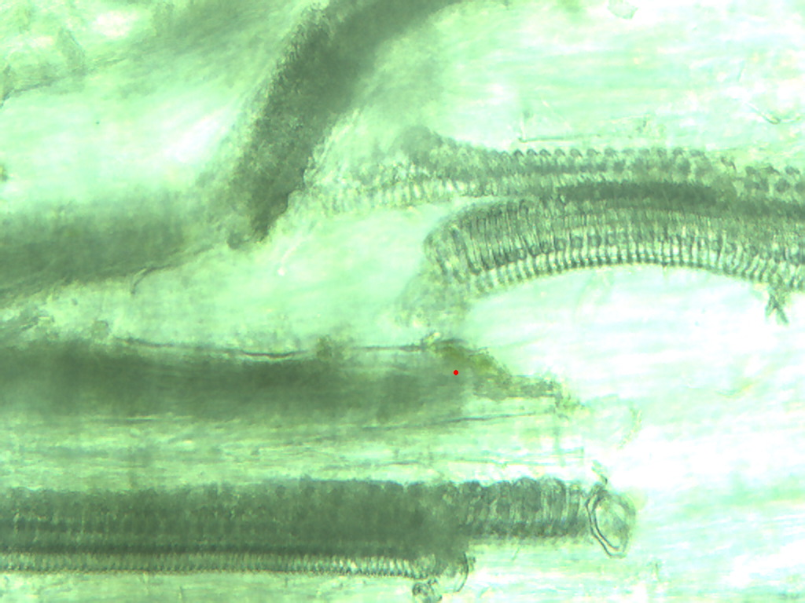
Notes:
339. Pea,snow. Vessels in pod, 25X.

Slide 7
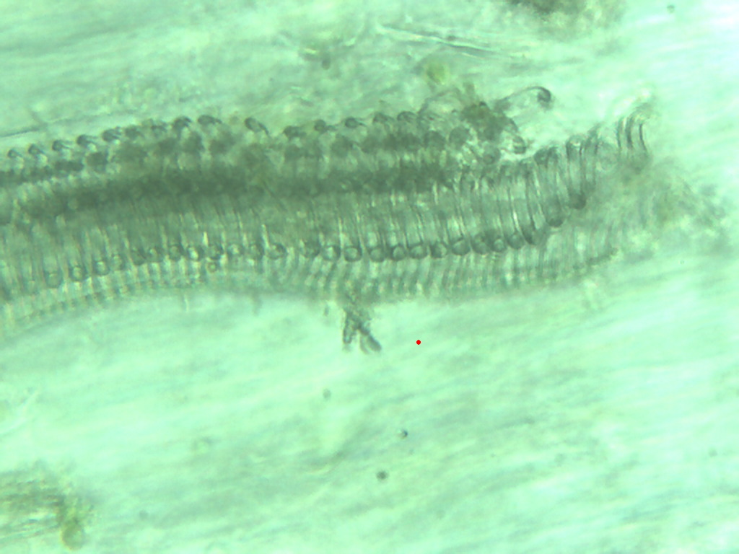
Notes:
340. Pea, snow. Vessels in pod, 40X.

Slide 8
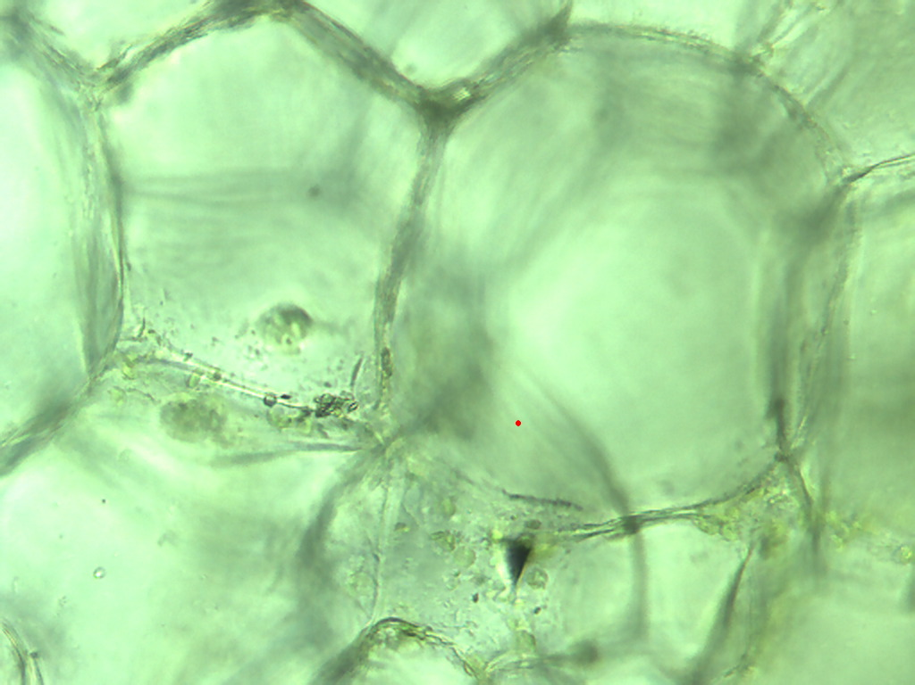
Notes:
341. Pea, snow. Large parenchymal cells in pod, 25X.

Slide 9
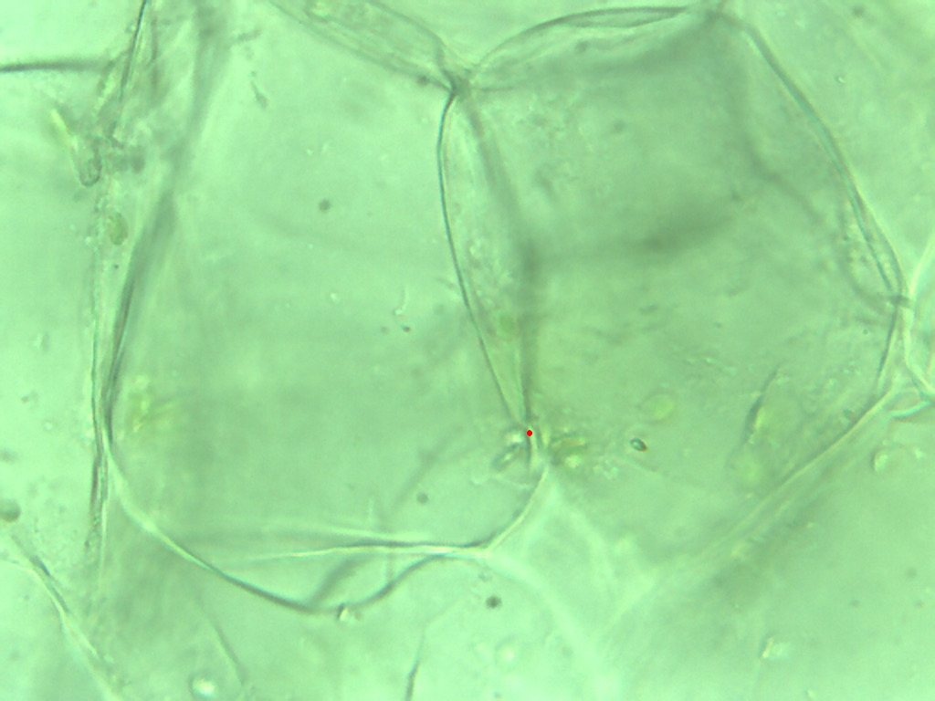
Notes:
342. Pea, snow. Large pulp parenchymal cells, 40X.

Slide 10
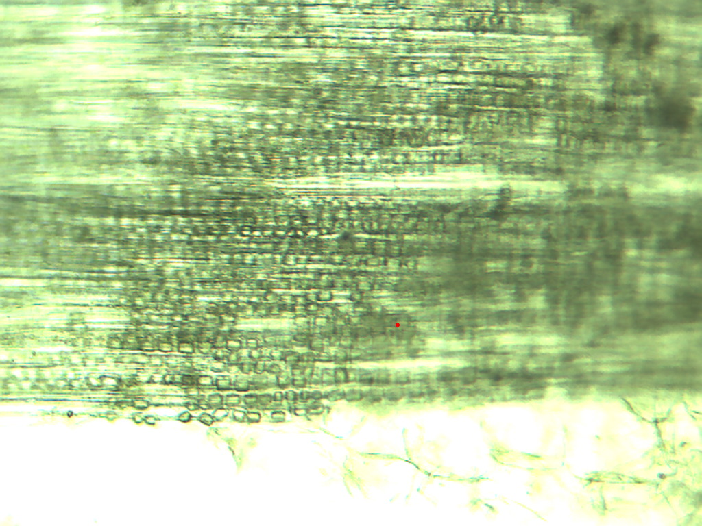
Notes:
343. Pea, snow. Pod cells, 10X.

Slide 11
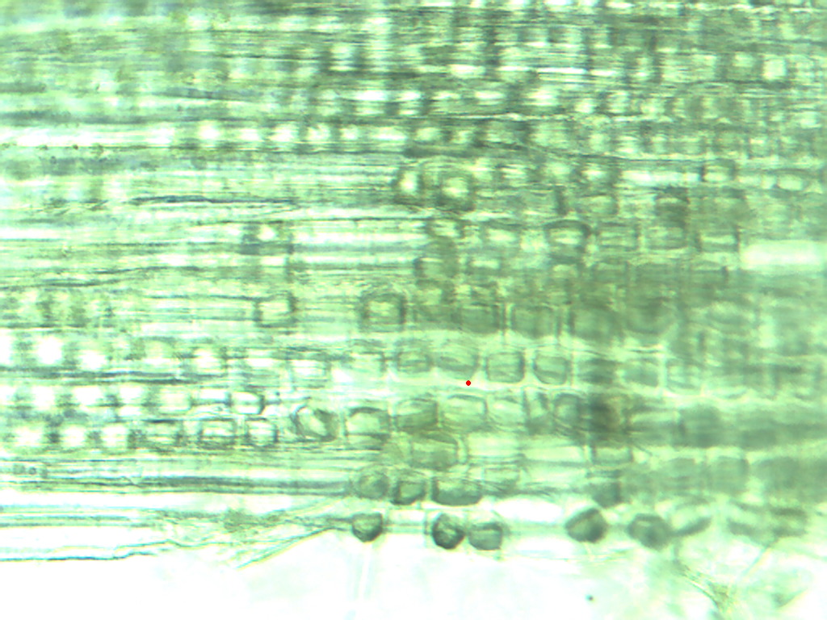
Notes:
344. Pea, snow. Pod cells, 25X.

Slide 12
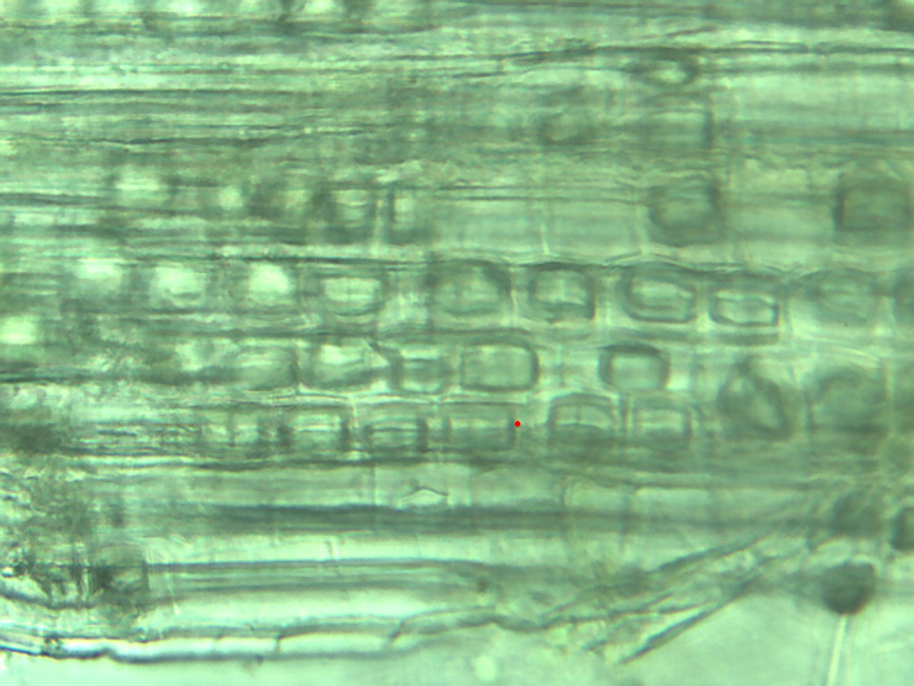
Notes:
345. Pea, snow. Pod cells, 40X.

Slide 13
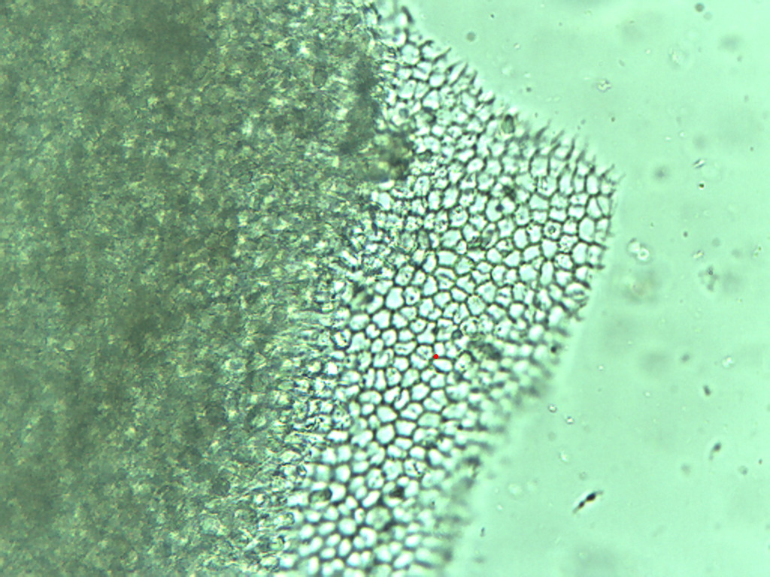
Notes:
346. Pea, snow. Seed coat, 25X.

Slide 14
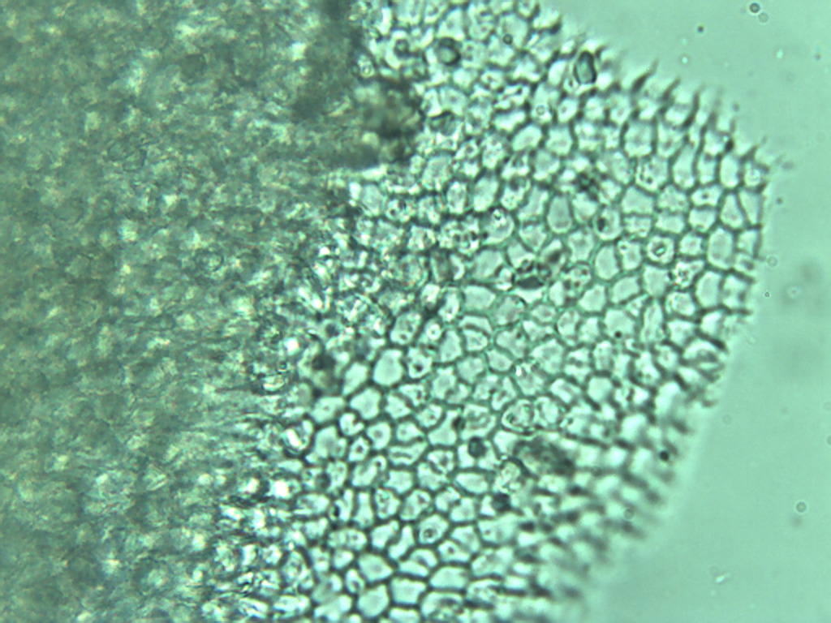
Notes:
347. Pea, snow. Seed coat, 40X.

Slide 15
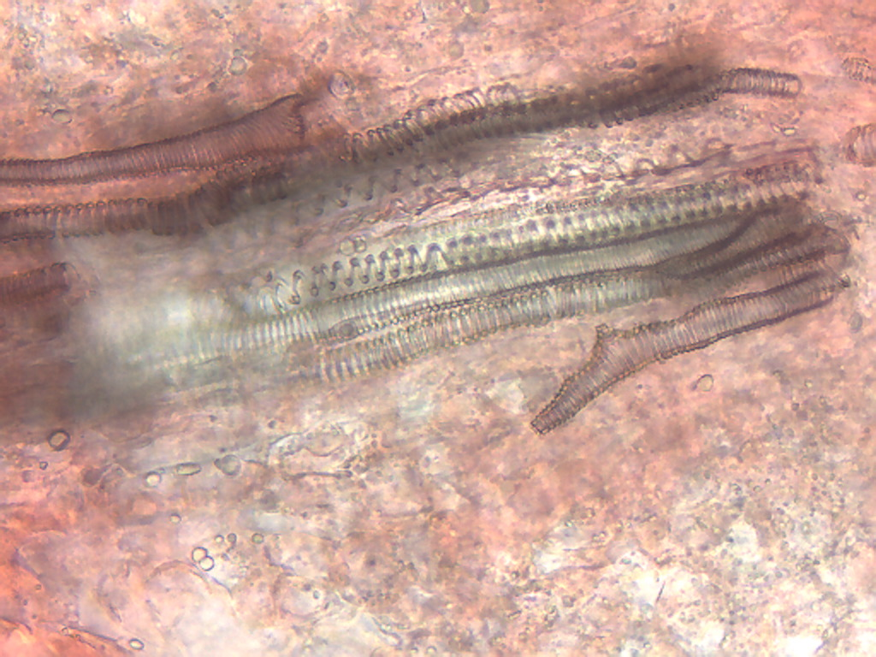
Notes:
348. Pea, snow. Seed vessels, 25X

Slide 16
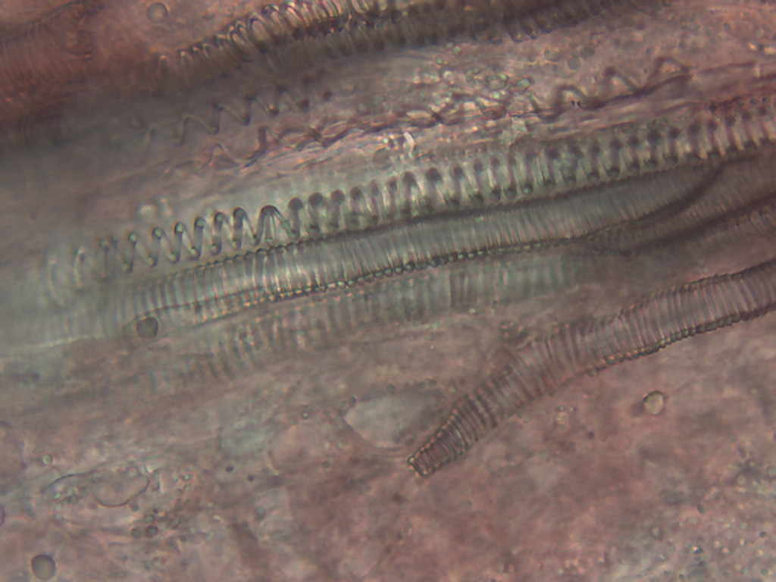
Notes:
349. Pea, snow. Seed vessels, 40X.

